Slide 2
Chapter 3
Cloud Computing Architecture

Slide 3
Learning Outcomes
At the end of the session you will be able to:
Comprehend characteristics of cloud computing
Define grid computing
Explain important features of cloud and grid computing
Describe grid architecture and cloud computing architecture
Differentiate between grid and cloud computing

Slide 4
Introduction
Grid computing is the integration of computer resources for achieving similar objective.
The grid may be a dispersed system along with non-interactive workloads which comprise a huge number of files.
Grids are frequently created with middleware software libraries of a common grid.

Slide 5
Grid Framework
Grids are a type of dispersed computing system, whereas a virtualized super computer is made from various networked.
Grids focus on two different but associated objectives—supplying isolated access to IT resources and building up processing control.
The grid is a technology which controls two factors—allocation and trust.
Grid computing is a versatile technology which has its base in e-science and has progressed from previous expansions in parallel and high-performance computing (HPC).

Slide 6
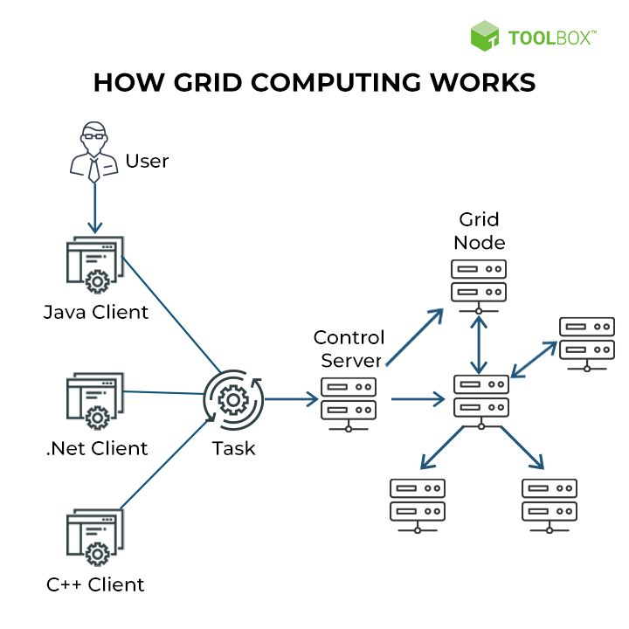
Grid Computing

Slide 7

Grid Computing

Slide 8
Grid Framework
The main resources that can be shared in a grid are:
1. Processing and computing power
2. Networked file and data storage systems
3. Bandwidth and communications
4. Application software
5. Tools used for scientific purpose

Slide 9
Grid Framework
The distinct definitions for grid and grid computing are:
Grid middleware is exclusive software that offers the essential functionality needed to facilitate sharing of various resources and setting up of virtual businesses. Grid middleware is exclusive software that is incorporated into the infrastructure of the concerned corporation. Grid middleware offers a unique virtualization and sharing layer which is positioned among the various infrastructures and the particular user applications using it.
Grid computing is fundamentally the installed Grid middleware or the computing permitted by grid middleware based on synchronized, safe, flexible resource sharing among a collection of resources, people, and organizations.

Slide 10
Grid Framework
Grid infrastructure refers to the union of grid middleware and hardware which converts single portions of data resources and hardware into an incorporated virtualized infrastructure that is displayed to the user as the only computer in spite of heterogeneity of the fundamental infrastructure.
Utility computing is a type of computing that provides customized applications of grid and computing as a service. It is based on pay-as-per-utilization business modules.

Slide 11
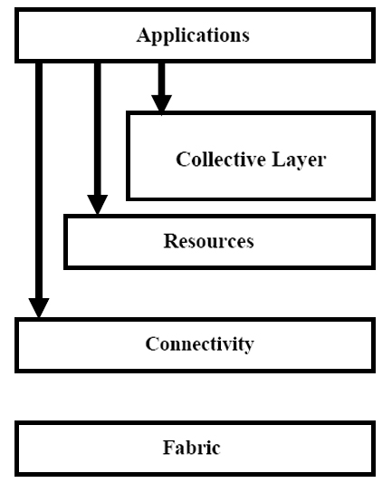
Grid Architecture
The grid design offers an outline of the grid constituents, describes the objective and operations of its constituents, and shows how the constituents interrelate with each other. Various layers of the grid architecture are:
Fabric layer
Connectivity layer
Resource layer
Collective layer
Application layer

Slide 12
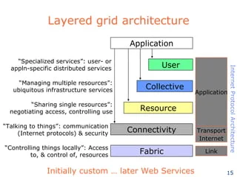
Grid Layers

Slide 13
Grid Architecture
The key functionalities of a grid middleware are as follows:
1. Integration and virtualization of various independent resources
2. Requirement of information concerning resources and their accessibility
3. Lively and flexible resource administration and allotment
4. Brokerage of resources based on open markets or corporation strategies
5. Safety comprising agreement and confirmation of users and accountability
6. Licenses administration
7. Expense and invoicing
8. Transport of non-insignificant ‘Quality of Service’

Slide 14
Challenges of Grid Computing
It is not enough to just change the prevailing spread IT infrastructure into a grid. In majority of instances, investments are required for making the existing applications to work on a grid infrastructure.
Lack of values for grid computing make resources’ findings for grid technology difficult and risky.
Grid computing is a versatile technology and the launching of grid computing in a corporation is characteristically a long-standing plan that needs time until the visibility of first results.
The beginning of grid computing could need consistency of physical resources. Even if grids would essentially be capable to handle heterogeneity of resources that are accessible, advanced heterogeneity of resources might need advanced savings in terms of money and time and hence increase the downfall risk.

Slide 15
Cloud Computing Architecture
In cloud computing environment, physical resources are made available to cloud users with the help of virtualization software in the form of virtual resources.
Cloud computing architecture is not fixed as other computing architectures, but it is different on the basis of different jobs, resource distribution.

Slide 16
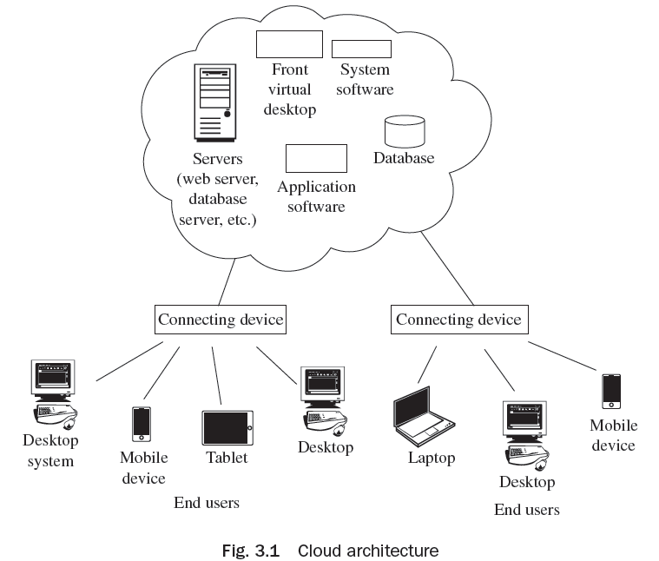
Cloud Computing Architecture
Basic cloud computing environment is shown in the Fig. 3.1 in which various services such as available servers, virtual desktop, system software, application software, database, etc. are available for cloud users. Users can avail the services using any device such as desktop system, laptop, mobile, tablet, etc.,

Slide 17
Cloud Computing Architecture
The Cloud Computing architecture is discussed based on different criteria:
On the Basis of Load Balancing
On the Basis of Disk Provisioning
On the Basis of Storage Management
On the Basis of Hypervisor Installed
On the Basis of Migration
On the Basis of Service Relocation
On the Basis of Cloud Balancing
On the Basis of Virtual Switches Load Balancing
On the Basis of Failure Detection and Recovery

Slide 18
Key Design Aspects of Cloud Architecture, Cloud Services and Cloud Applications
Cloud computing has various issues related to its architecture:
Issues at Design Level
Issues of Architectural of Cloud Computing
Platform Related Issues
Issues Related to the Implementation
Issues related to Business
Technical Issues

Slide 19
Similarities and Differences between Grid and Cloud Computing
Similarities:
Grid computing and cloud computing are scalable.
Grid and cloud computing offer service-level agreements (SLAs) for uptime accessibility of around 99 per cent. If the service slides below the definite uptime service level, the service credit for receiving data to the customer gets delayed.
Differences:
Cloud computing offers SaaS applications, whereas grid computing is used when the processing authority of service or an application is distributed across multiple systems.
With cloud computing, the corporation acquires feasibility and expense savings, whereas with grid computing the corporation acquires suppleness and authority.

Slide 20
Features of Cloud Computing
On-demand self service
Broad network access
Resource pooling
Rapid elasticity
Measured service
Multi-persistence
Dynamic Computing Infrastructure
Elasticity and scalability
IT service-centric approach
Standardized Interfaces

Slide 21
Cloud and Dynamic Infrastructure
Cloud service characteristics include reduced cost, high scalability, pay-as-you-grow facility, guaranteed data center and network uptime, better resource utilization, and lesser implementation time since resources are available on demand.
Cloud services are exclusive as they permit to see, amend and share files saved on the cloud. At the same time, as no two cloud services are alike, all of the services offer almost similar basic functionality and features.
The finest cloud computing services are those which permit to store and upload any sort of file one would keep on his/her local hard drive, from word documents to music files. Security issues can be solved by file encryption, and password sharing is restricted to protect the data.

Slide 22
Cloud and Dynamic Infrastructure
Points to consider while selecting a cloud provider as per the requirement are given below:
Ease of use
Help and support
Packaged software
Shared software
Tool management
Mobile access
Line of business services
Customer-oriented services

Slide 23
Impediments to Cloud Adoption
Businesses must vigilantly think about five chief barriers for prosperous implementation of cloud computing. These are as follows:
Security
Privacy
Irresponsibility of vendors
Risk improvement
Inheritance of applications

Slide 24
Thank You!

